Slide 1
Online Recipe Management
Amulya Pabbu, Ajay Danam, Rohith Yalavarthi
(Student Id: 700745862,700755681,700745581, CRN:30698, Group number:4)

Slide 2
INTRODUCTION
The “Online Recipe Management” is a user-friendly application designed to streamline the management of recipes.
It serves as a centralized platform where users can store, organize and retrieve their favorite recipes effortlessly.
The application aims to provide a convenient solution for individuals who love cooking or want to maintain a digital collection of recipes, ensuring easy access and efficient management of culinary creations.
It allows users to categorize recipes using tags or categories, simplifying the process of finding recipes based on specific criteria.
The primary roles are admin and users.

Slide 3
ADMIN module
Admin can login using his credentials.
Admin can add, modify or delete categories.
Admin can add, modify or delete subcategories.
Admin can add, modify or delete recipes.
Admin can view, approve or reject user added recipes.
Admin can view or delete registered users.

Slide 4
User Module
Users can register themselves into this application by providing some basic information like full name, contact number, email, address and password.
Users can view all available recipes in this application.
Users can also share recipes in this application.
Added recipe will be approved or rejected by the admin and once the recipe is approved it can be viewed by other users.
Users can also update or delete their recipes.

Slide 5
Database description & Business rules
The “Online Recipe Management” stores various pieces of information associated with each recipe in this application, where users can add recipes and those recipes can be viewed by other users.
There are two major roles used in this application they are admin and users.
Admin has overall access to all the data. Admin can login into this application using their default credentials. Admin can add categories like vegetarian and non-vegetarian, etc.. and subcategories like breakfast, lunch, dinner etc.. Admin can also add recipes with details.
Admin can view registered users, can remove any registered users and can approve or reject any recipe from the application.

Slide 6
Database description & Business rules
User should be registered into this application to view the recipes, user can register themselves by providing details like name, email, mobile, address and password.
User can login using their credentials.
User can view the available recipes added by admin or other users. User can add a new recipe to this application.
Admin will review and can approve or reject the recipe added by the user.
User can filter the recipes based on the name of a recipe or by the nutritional information.

Slide 7
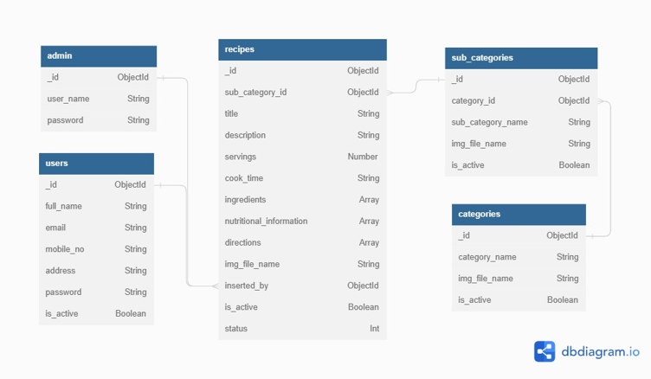
Entities and relationships

Slide 8
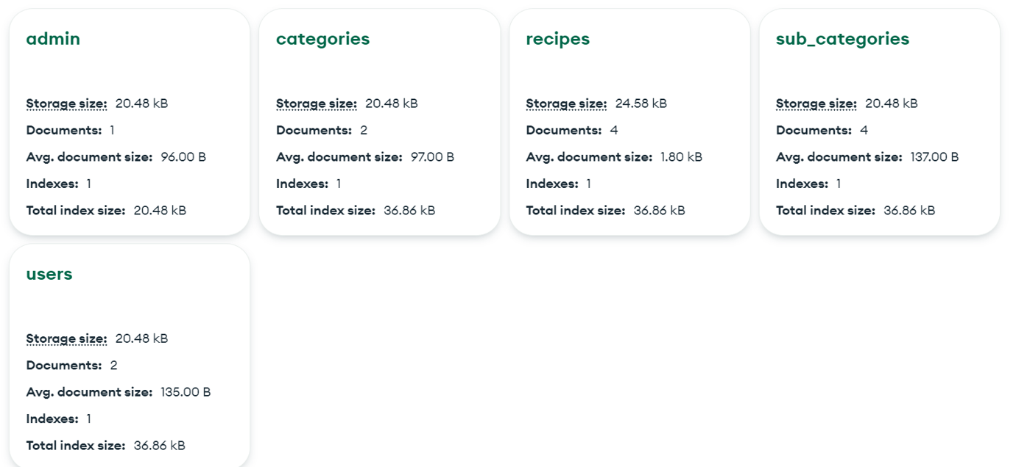
Db collections

Slide 9
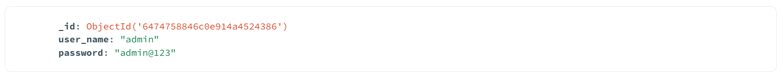
admin collection

Slide 10
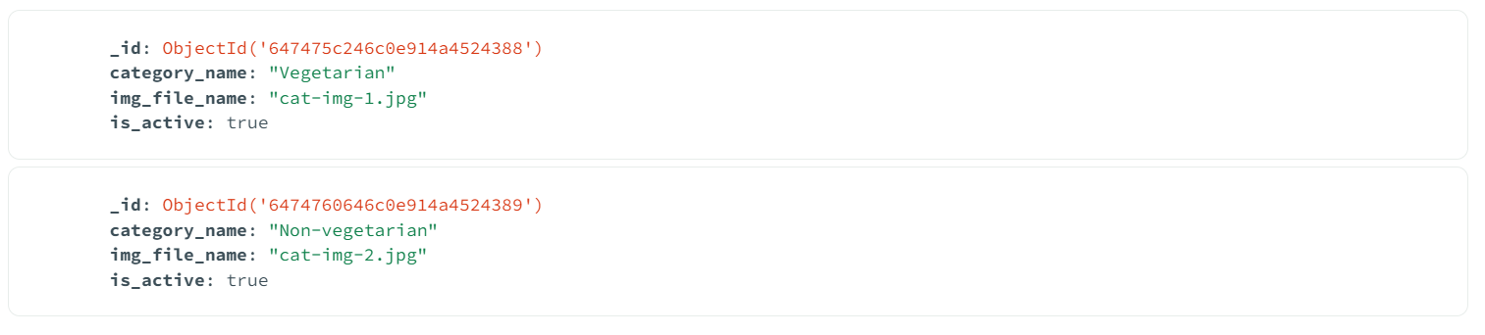
Categories collection

Slide 11
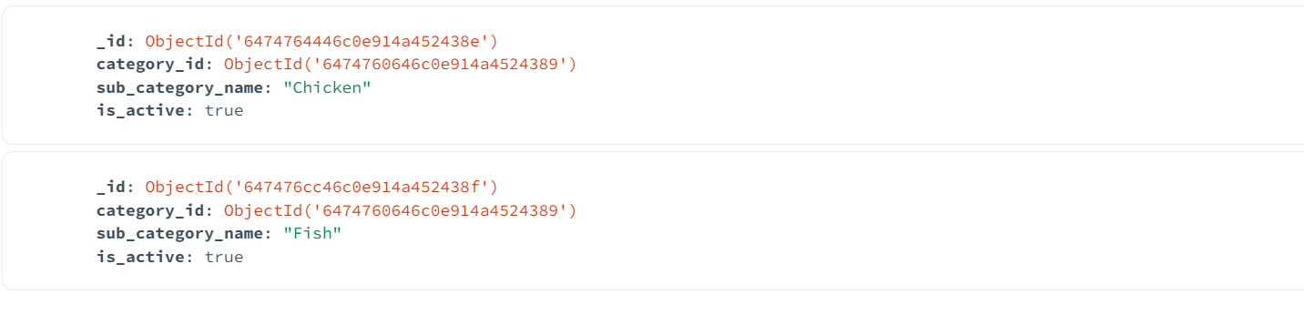
Subcategories collection

Slide 12
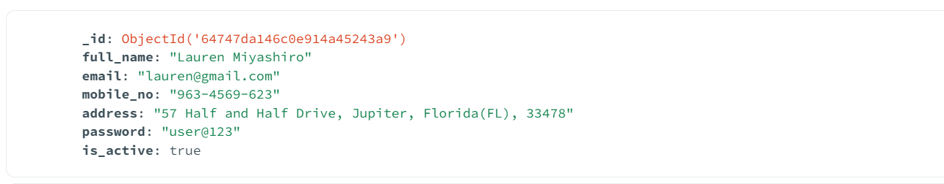
users collection

Slide 13
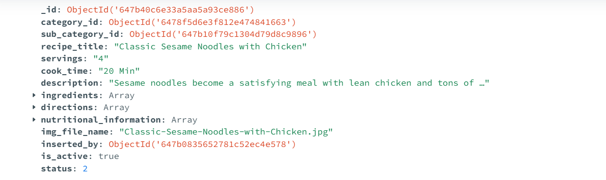
Recipes collection

Slide 14
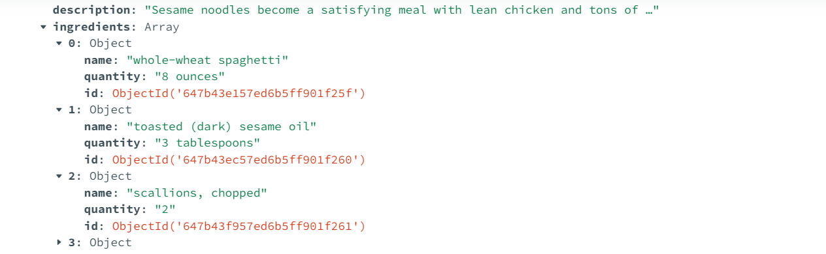
Recipes - ingredients collection

Slide 15
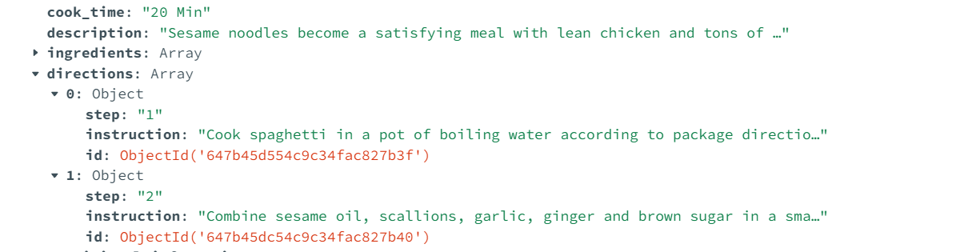
Recipes - Preparation Instructions collection

Slide 16
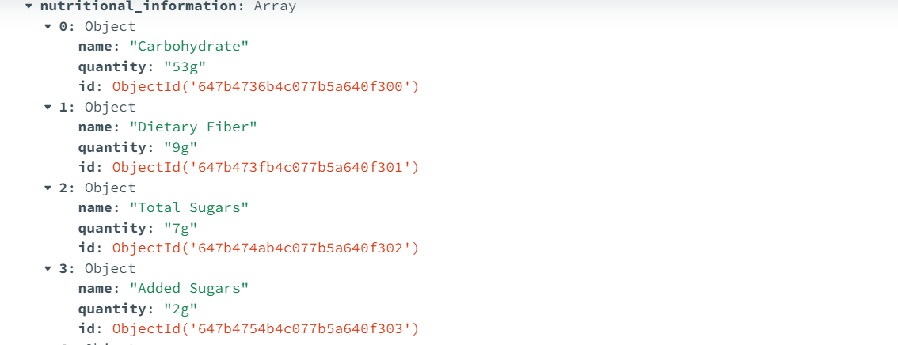
Recipes - Nutritional Information collection

Slide 17
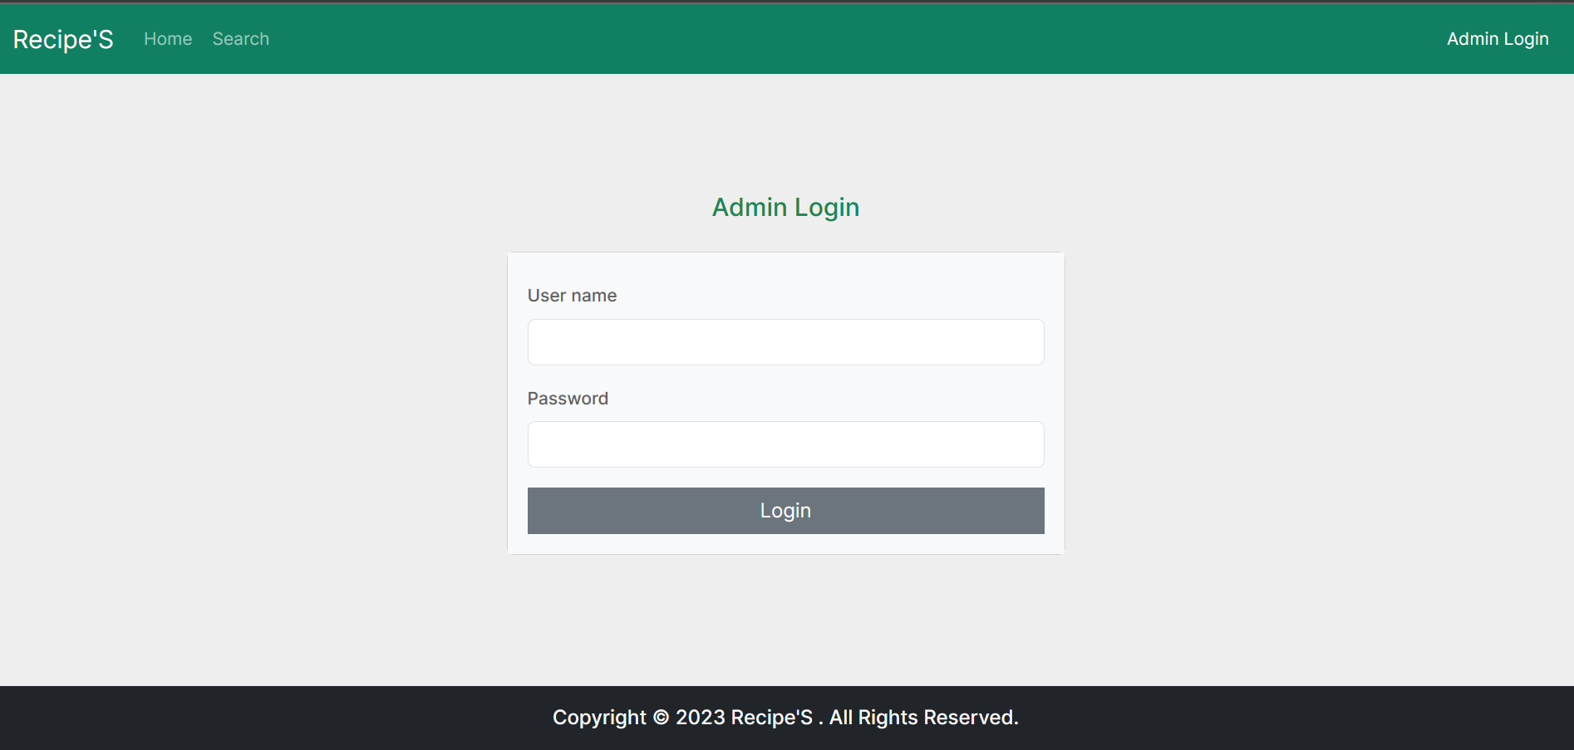
Screenshot – admin login

Slide 18
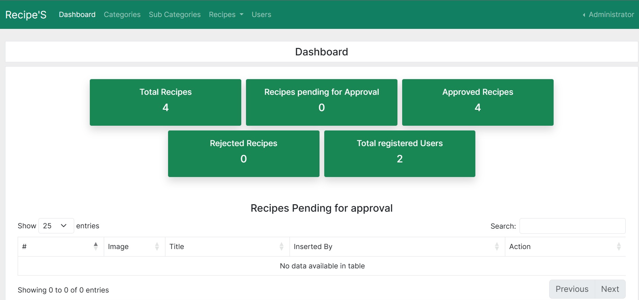
Screenshot – Admin dashboard

Slide 19
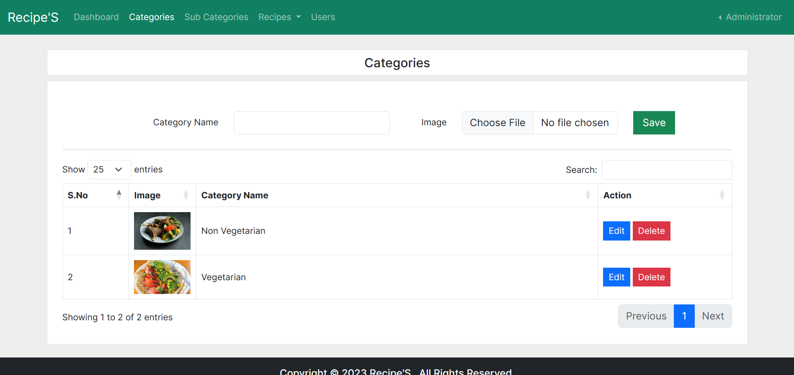
Screenshot – admin categories

Slide 20
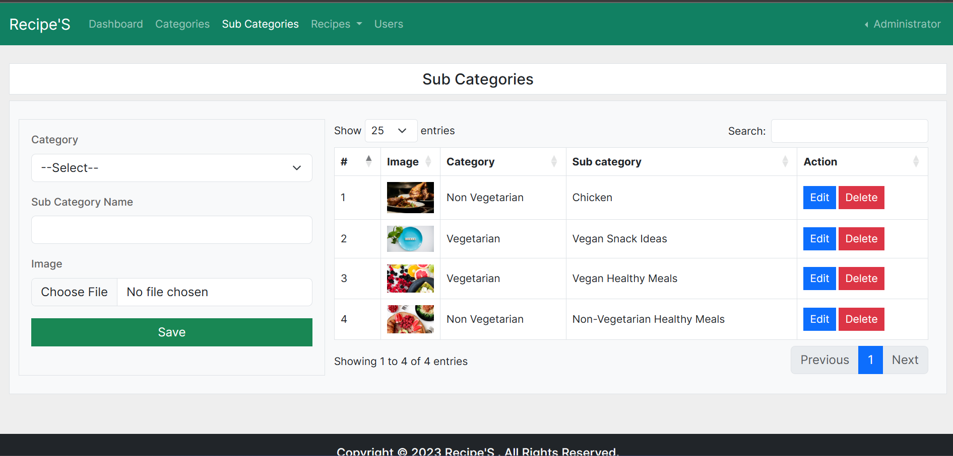
Screenshot – Admin sub-categories

Slide 21
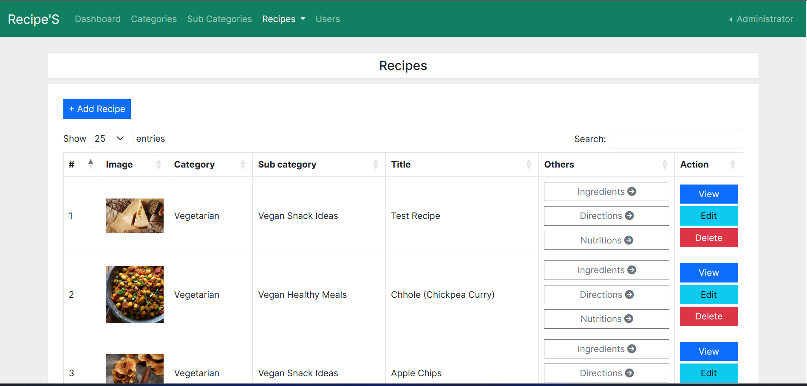
Screenshot – admin recipes

Slide 22
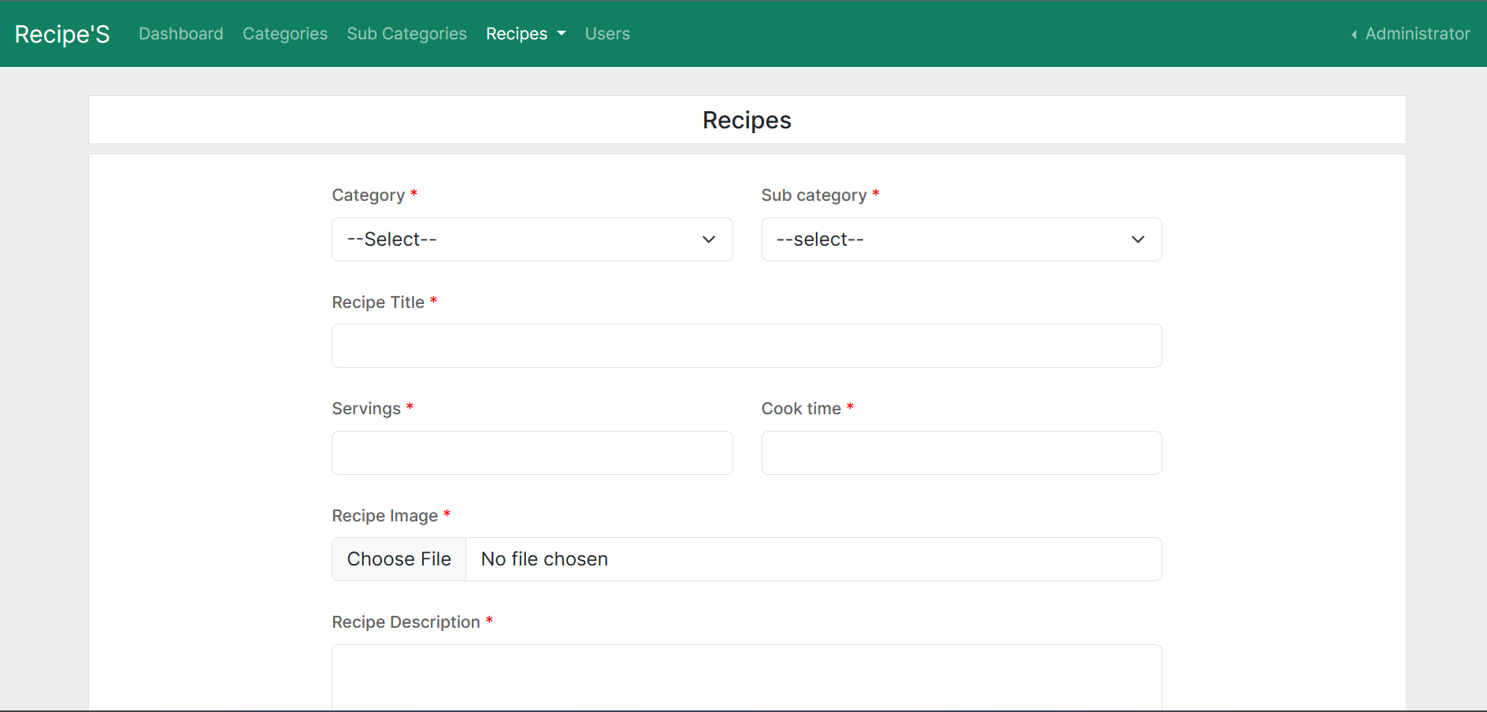
Screenshot – admin ADD/EDIT recipes

Slide 23
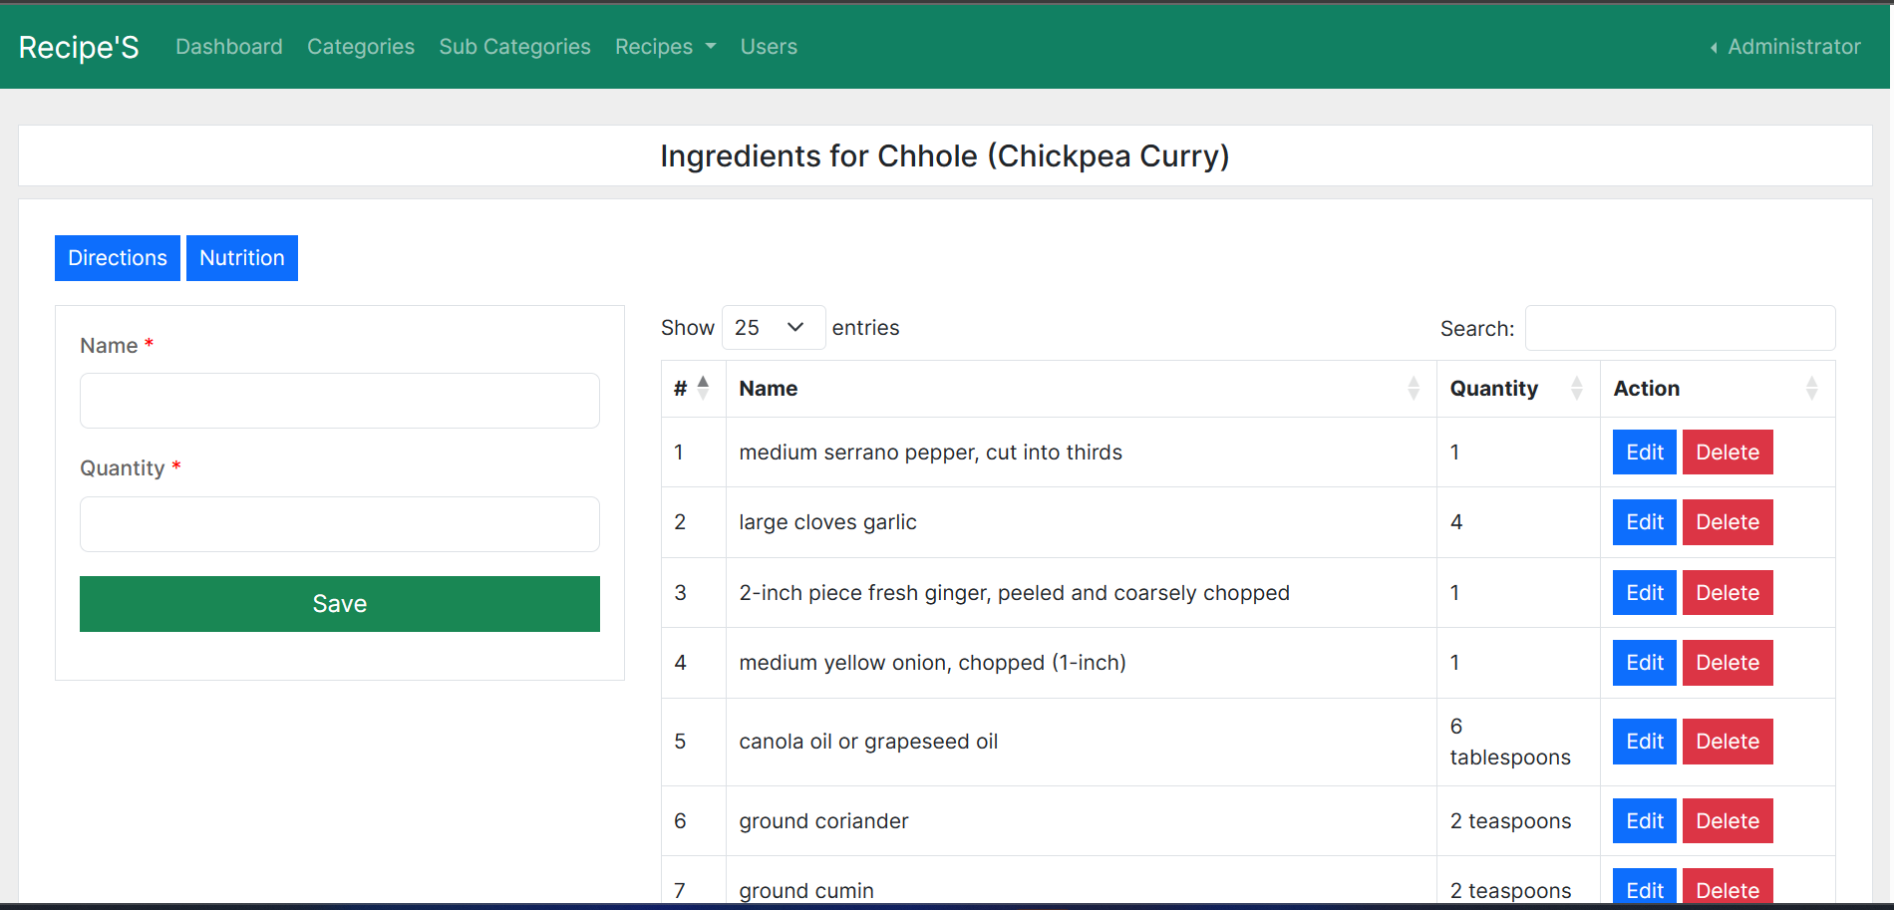
Screenshot –admin recipe ingredients

Slide 24
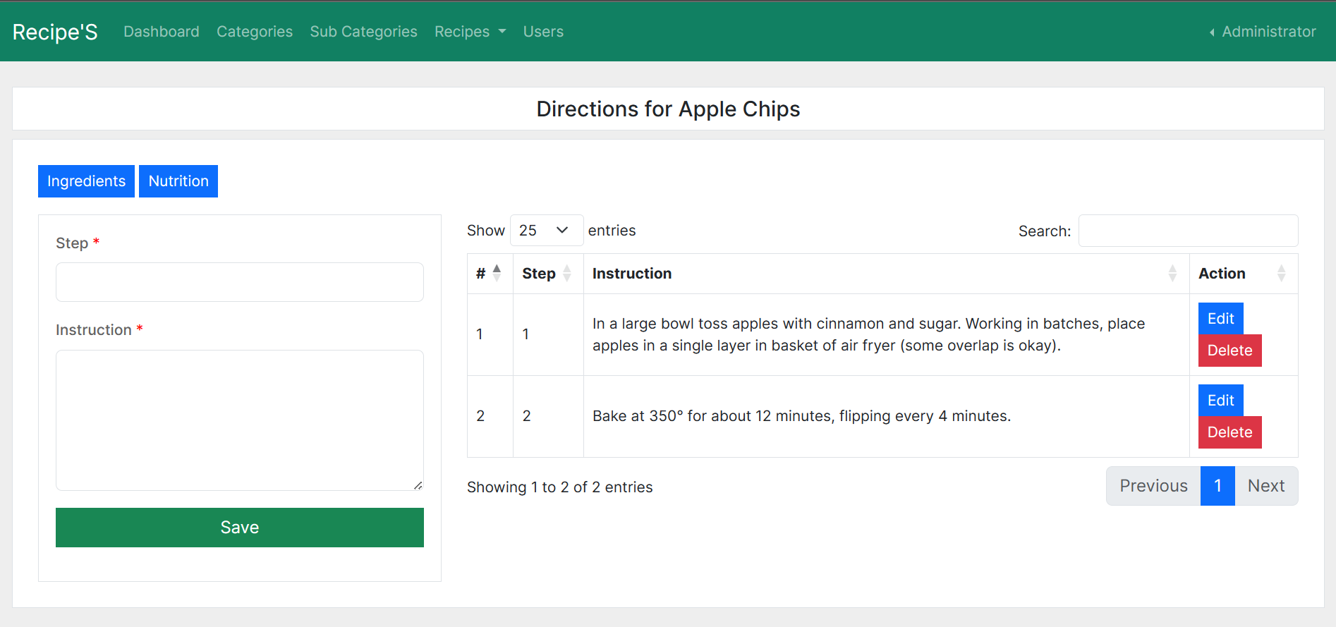
Screenshot – admin recipe directions

Slide 25
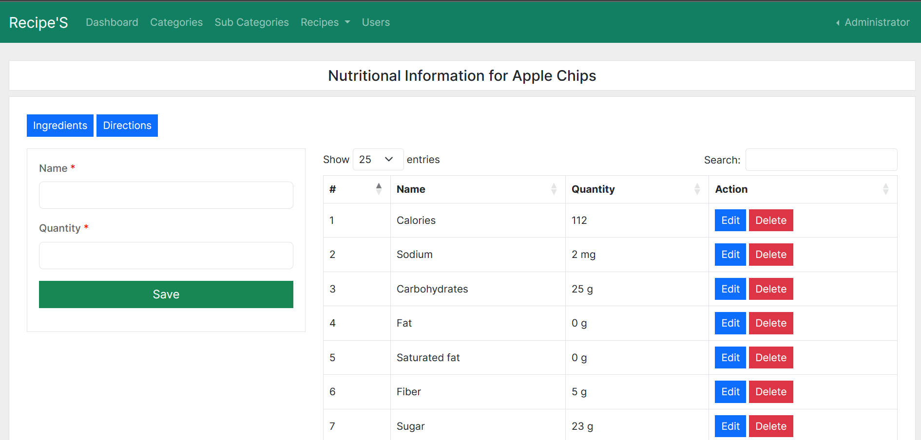
Screenshot – admin recipe nutritional information

Slide 26
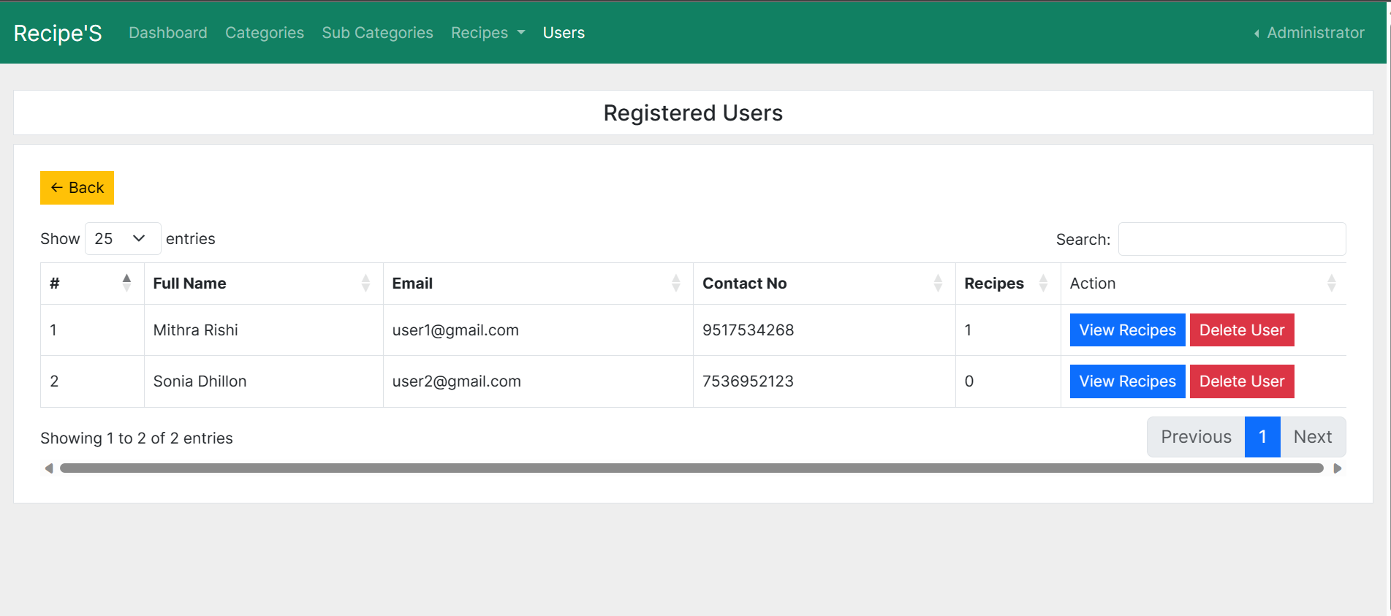
Screenshot – admin view users

Slide 27
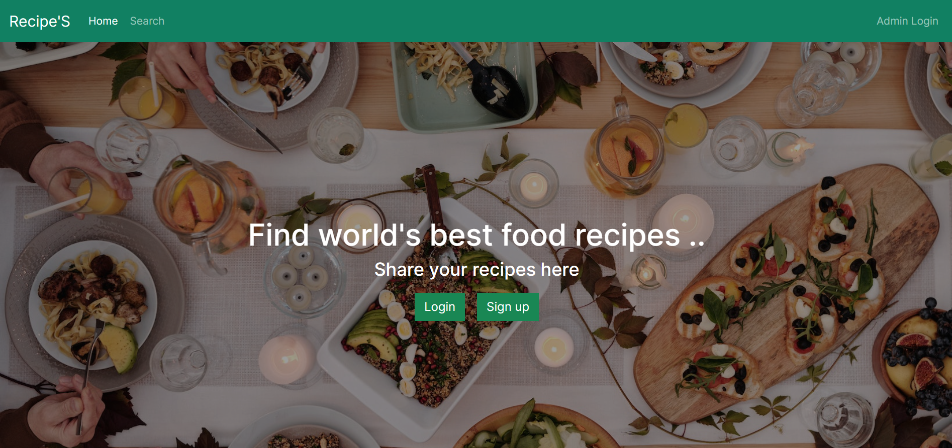
Screenshot –Home Page

Slide 28
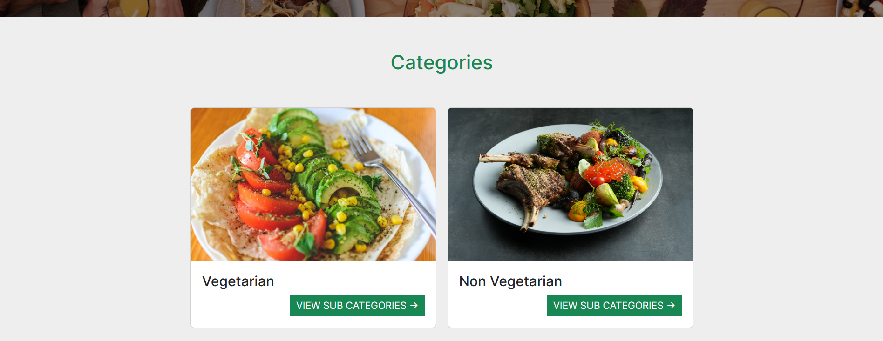
Screenshot –Categories page

Slide 29
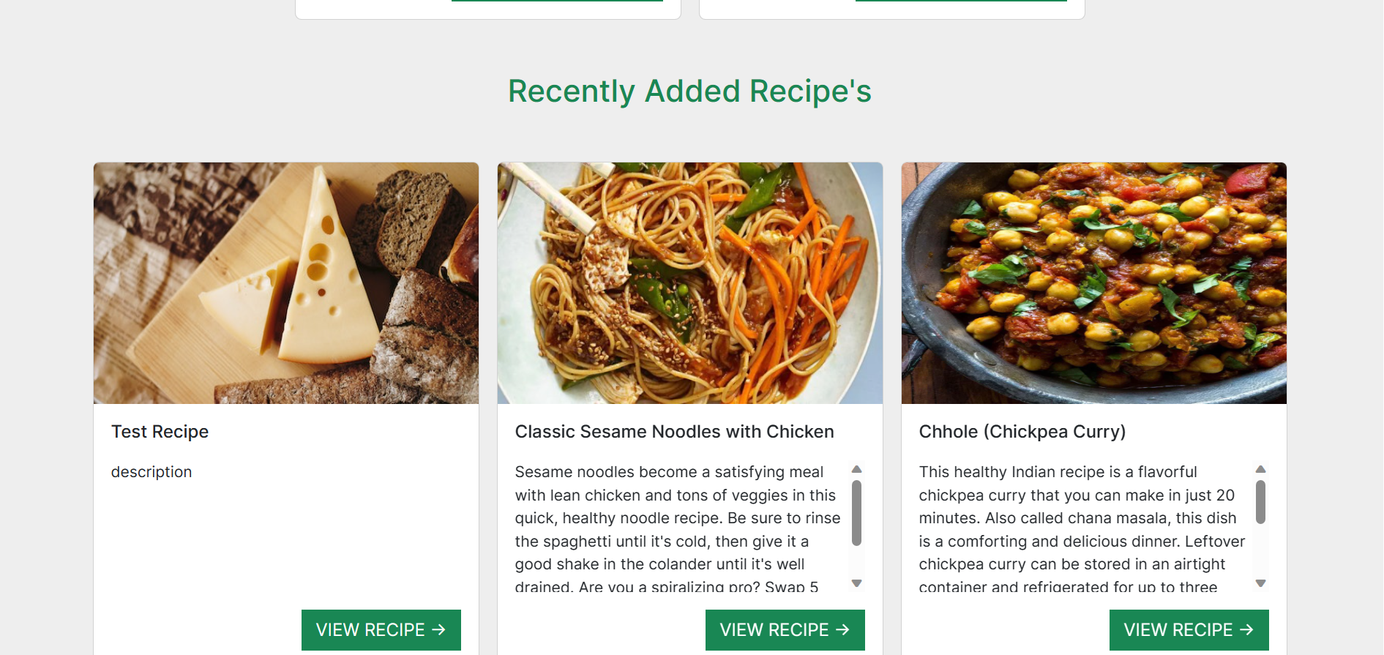
Screenshot –Added Recipes

Slide 30
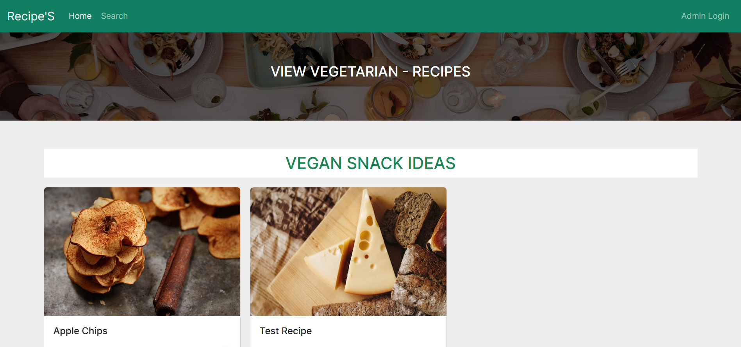
Screenshot –Vegetarian recipes

Slide 31
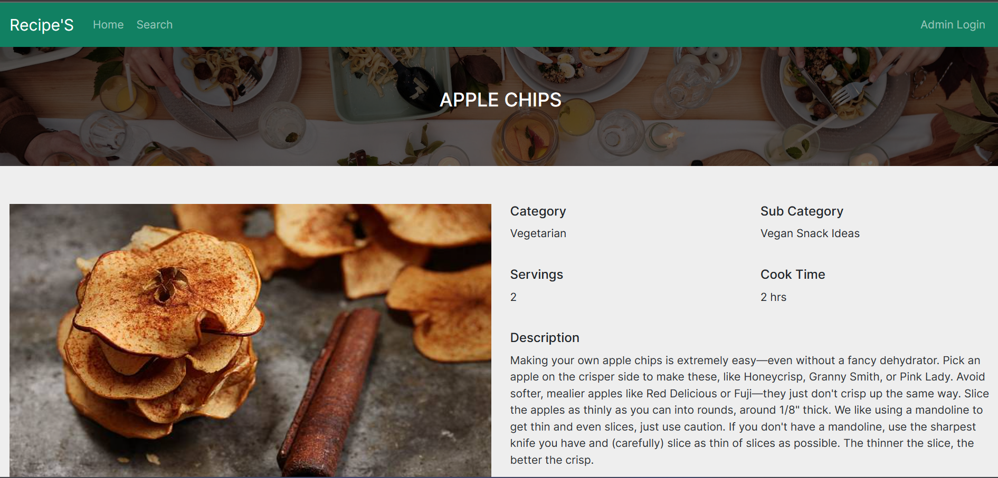
Screenshot –recipe details

Slide 32
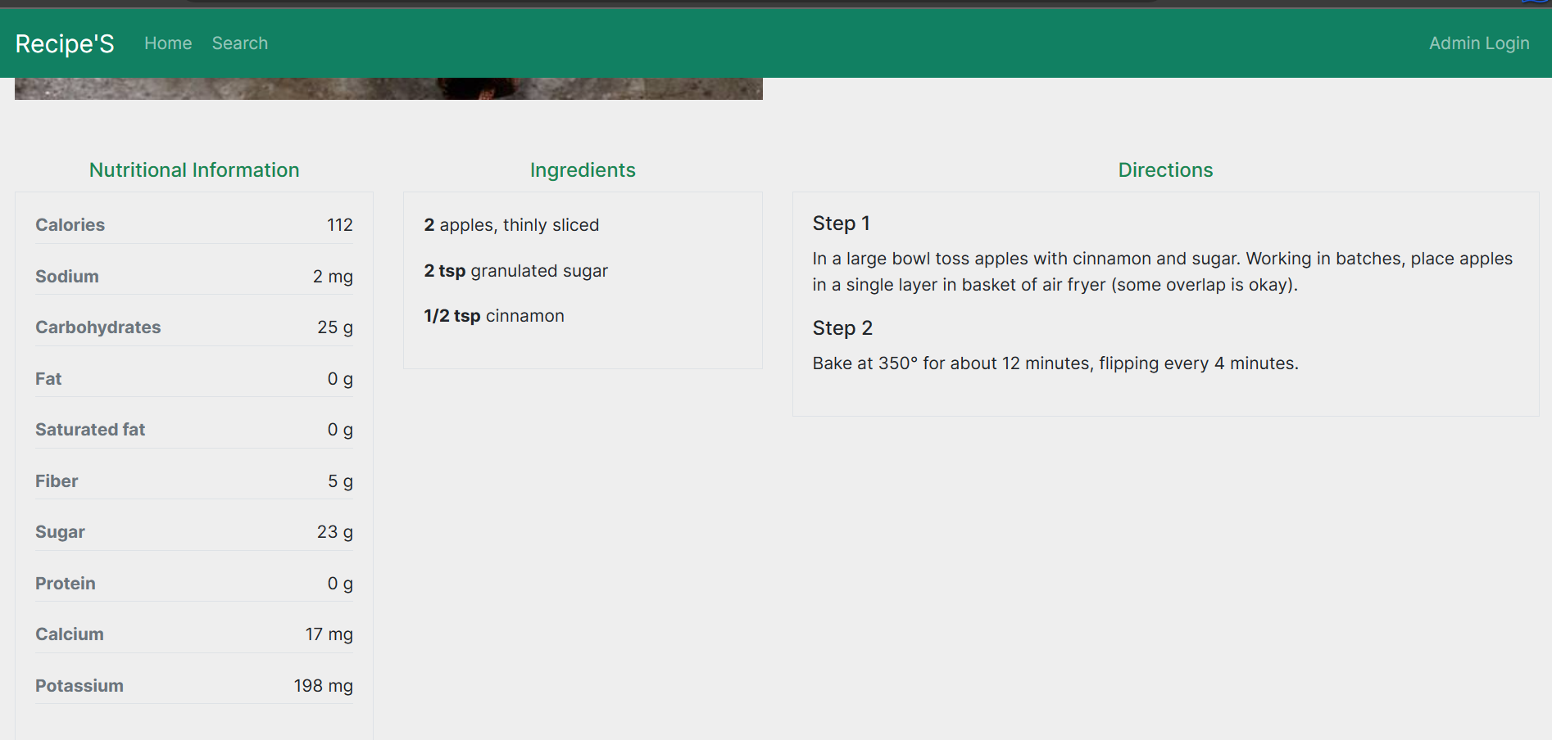
Screenshot –Recipe details

Slide 33
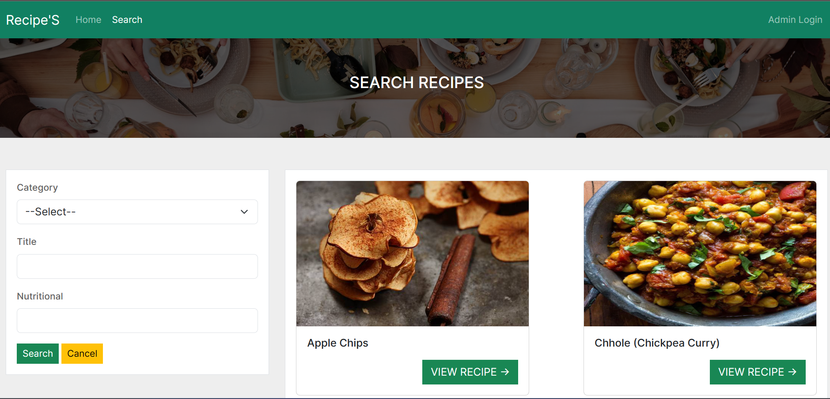
Screenshot –Search page

Slide 34
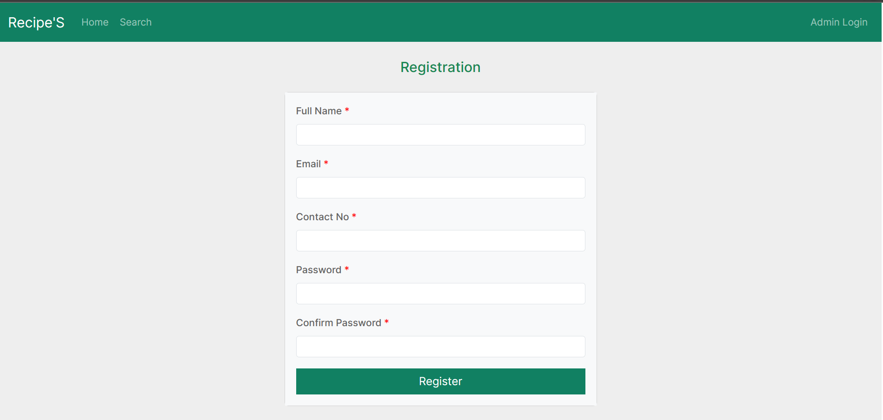
Screenshot –user Registration

Slide 35
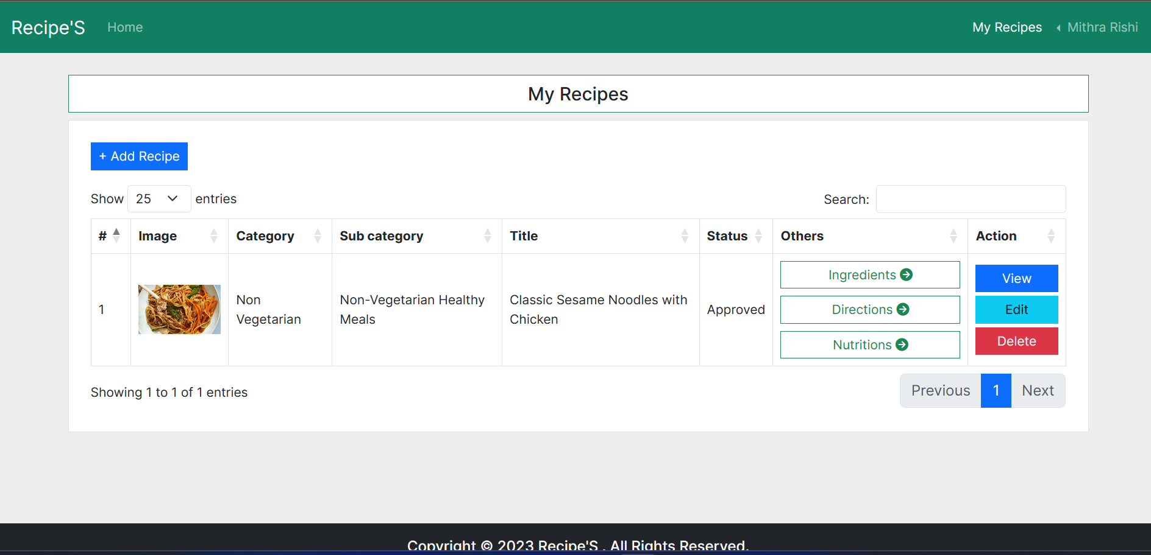
Screenshot –User added recipes

Slide 36
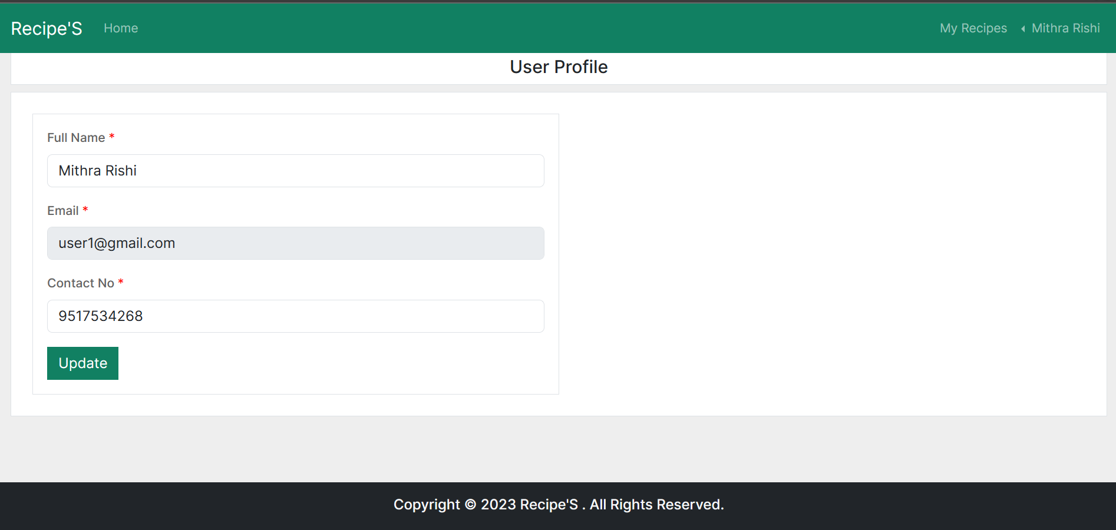
Screenshot –User profile page

Slide 37
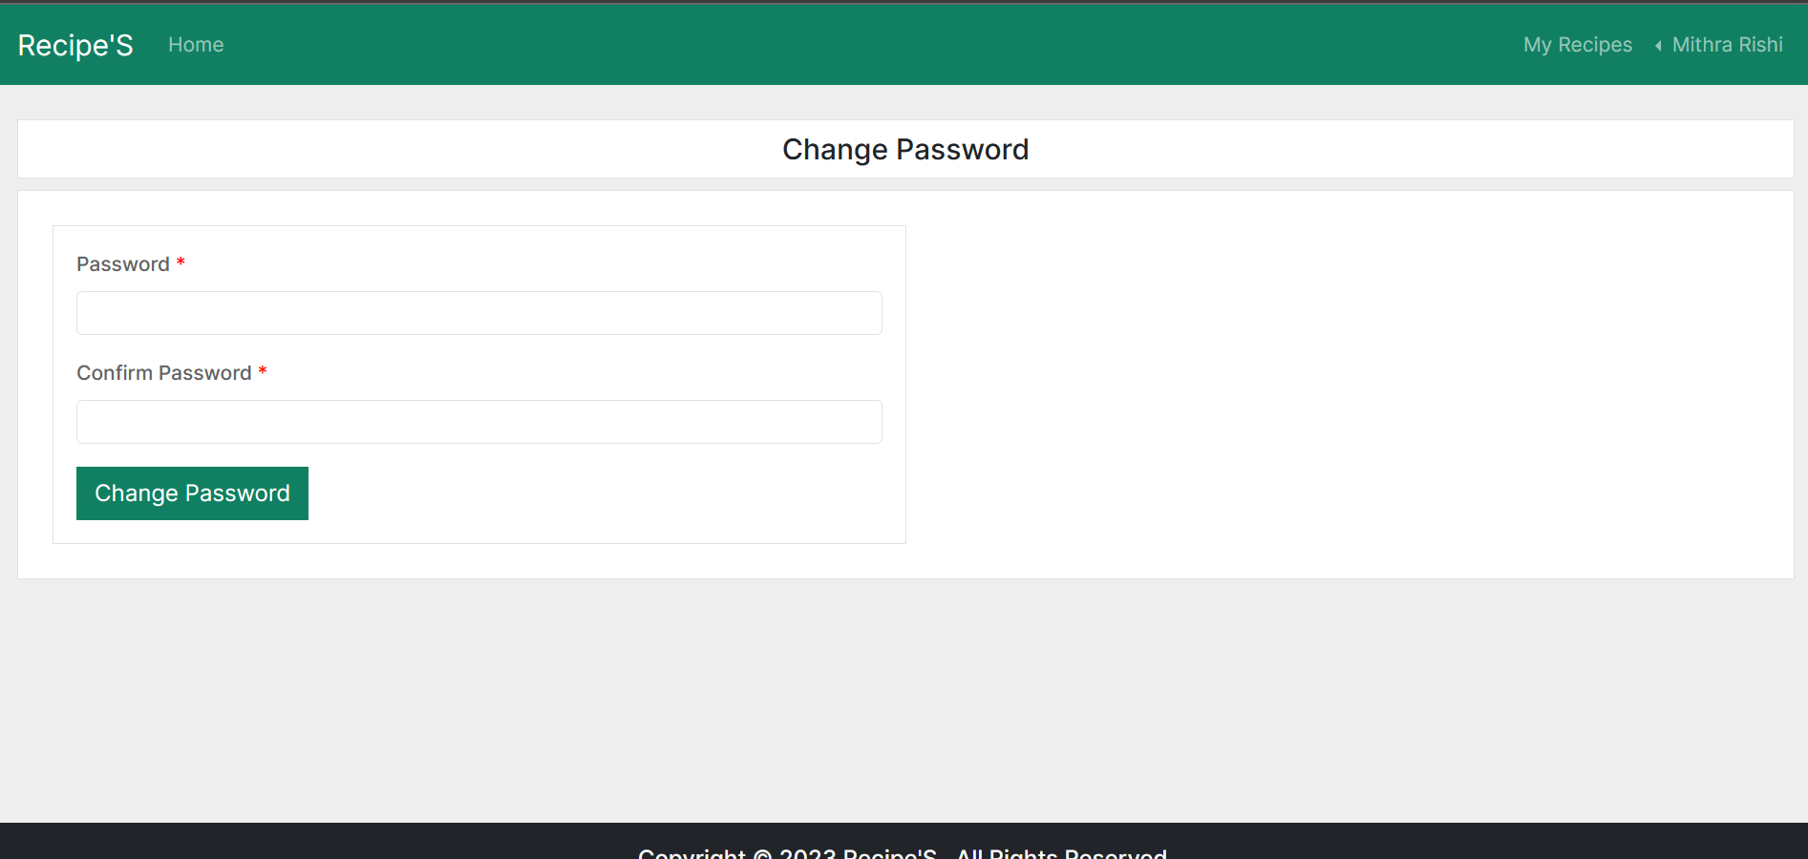
Screenshot –Password change page

Slide 38
Plugins used
CSS
Bootstrap 5.3.0
Bootstrap is the most popular CSS Framework for developing responsive and mobile-first websites.
https://getbootstrap.com/
Font Awesome
Font Awesome gives you scalable vector icons that can instantly be customized — size, color, drop shadow, and anything that can be done with the power of CSS.
https://fontawesome.com/

Slide 39
Plugins used
JavaScript & jQuery
jQuery data tables
Data Tables is a powerful jQuery plugin which can be used to create HTML tables with functionality like searching, sorting and pagination. It can use almost any data source like DOM, Ajax, and server-side processing. It is mobile friendly library which can adapt to the viewport size.
https://datatables.net/
jQuery validations
This jQuery plugin makes simple clientside form validation easy, whilst still offering plenty of customization options. The plugin comes bundled with a useful set of validation methods, including URL and email validation, while providing an API to write your own methods.
https://jqueryvalidation.org/

Slide 40
Thank you

